Slide 1
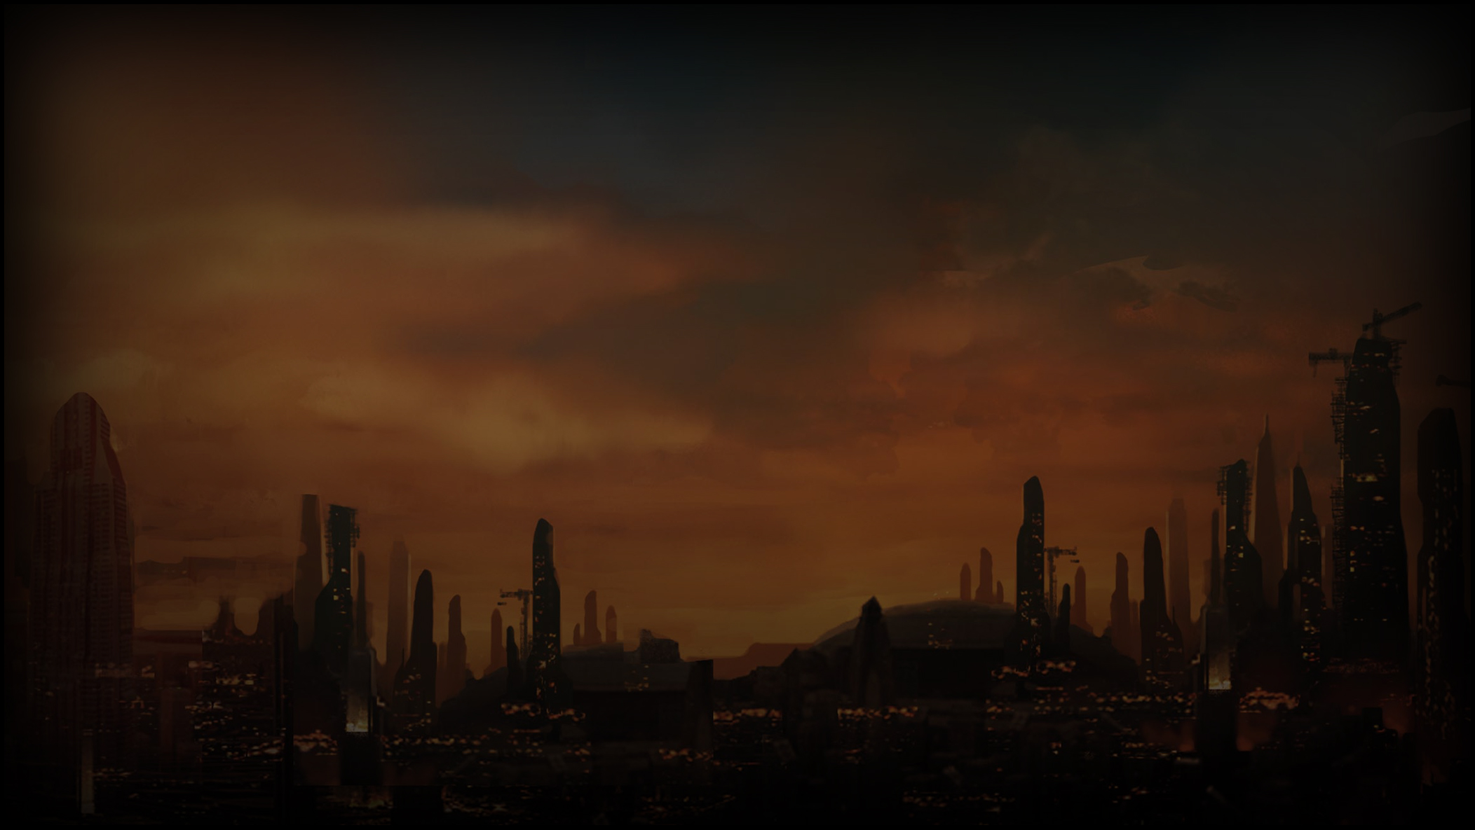
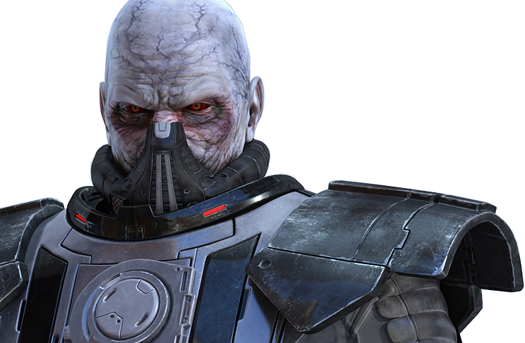
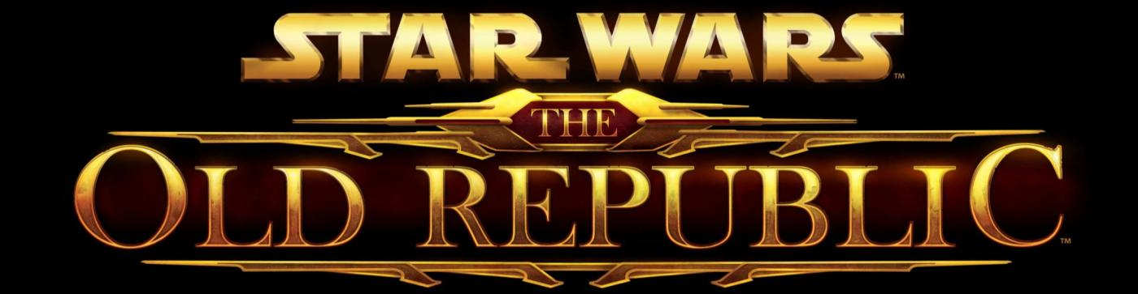
Behind the Curtain
Using MMO Systems to tell BioWare-quality Stories
Damion Schubert
damion@zenofdesign.com

Slide 2
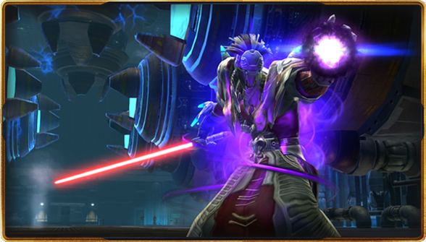
Who am I?
Currently:
  Lead Systems Designer on Star Wars™: The Old Republic
Formerly:
  Senior Designer/Lead Designer/Producer, Shadowbane
  Lead Designer, Meridian 59
  Columnist for Game Developer magazine
  Frequent GDC speaker
NOT a writer

Slide 3
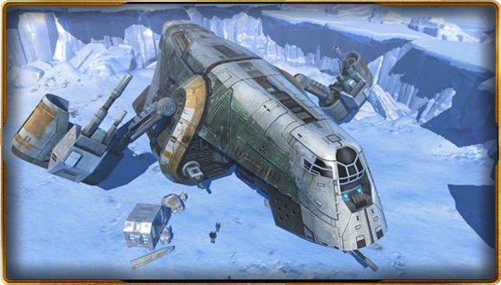
This Talk
Not about
  Narrative
  Character development
  Leveraging a license
  Other writer stuff
Is About
  Player experience
  Gameplay flow of story
  Social flow of story in MMO
  Interaction with game systems
How game systems interact and support MMO storytelling

Slide 4
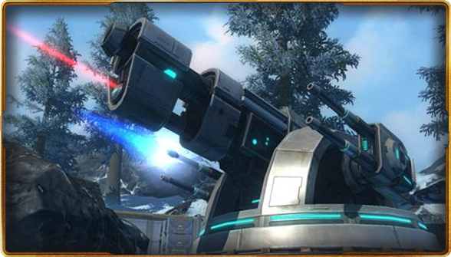
MMOs are Hard
  Client-server architecture
  MASSIVE amounts of content –
    Most MMOs required 250 hours to get to max level at ship
    Factional split can increase further
  Class balance becomes crucial
  Social gameplay and social issues
  Billing, Security, Credit Card Fraud, etc

Slide 5
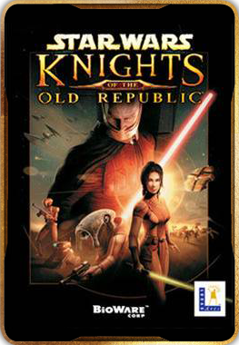
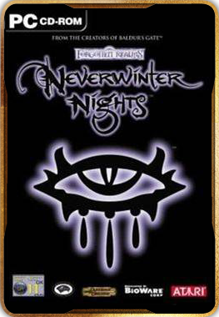
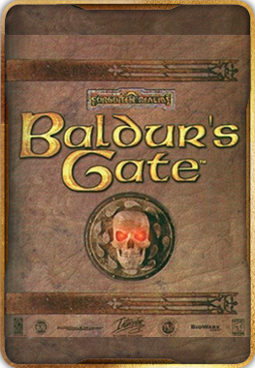
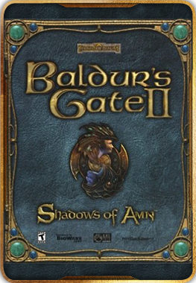
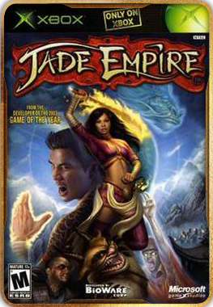
BioWare Wants to Enter the Fray
  BioWare has one of the most impressive resumes in the games industry
Average Metacritic Score: 91.8

Slide 6
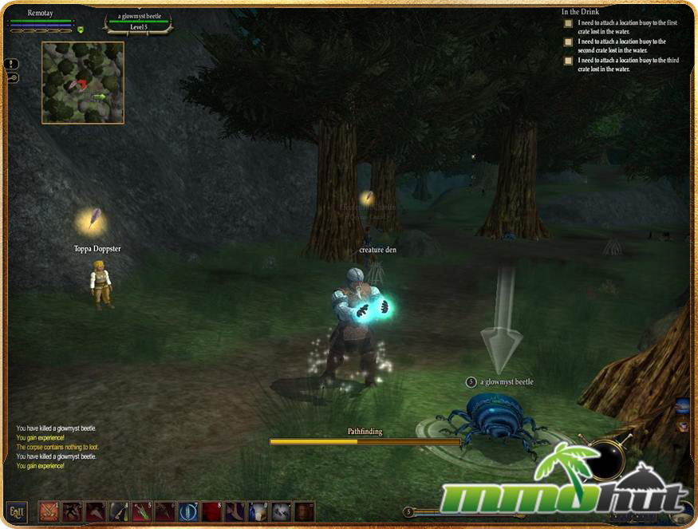
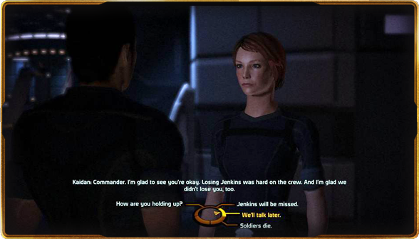
The Big Idea
Add BioWare-Quality story to the MMO experience
+

Slide 7

+ Star Wars
  The best geek license of all time
  Plus uniquely suited to an MMO
    Human and non-human enemies
    Strong visual combat
    Strong heroic arc
    Casual friendly and hardcore deep
  Also, BioWare has experience from Star Wars™: Knights of the Old Republic ™

Slide 8
So Wait…. What Is the BioWare Story?

Slide 9
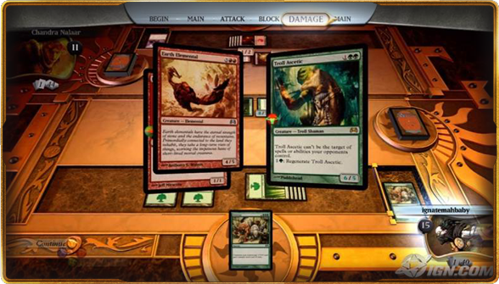
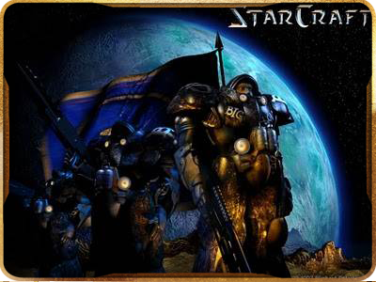
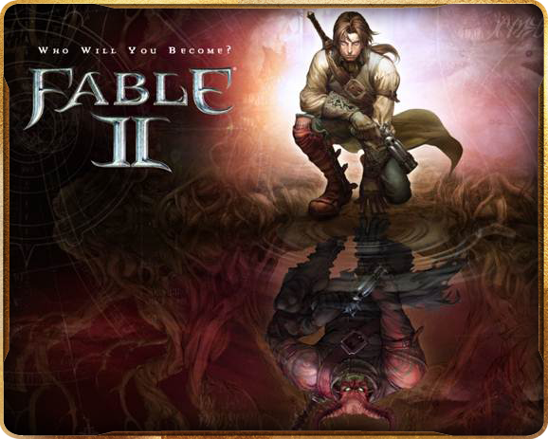
Story means different things in different games
Backstory vs. Player Involvement vs. Player Directed

Slide 10
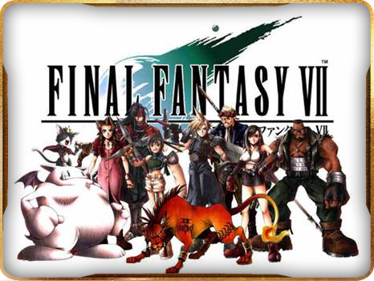
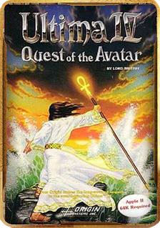
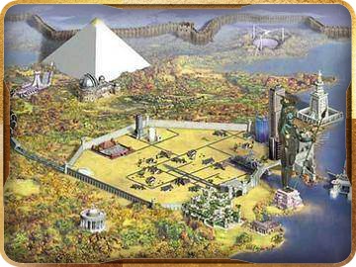
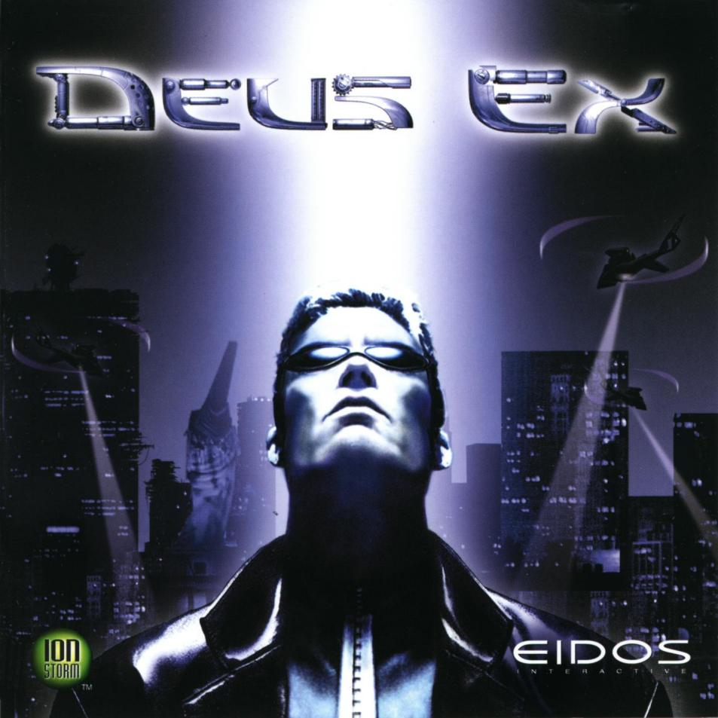
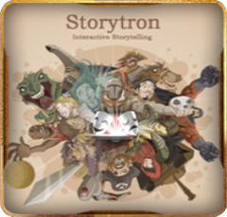
Story means different things in different games
Linear vs. Branching vs. Freeform vs. Generative vs. Emergent

Slide 11
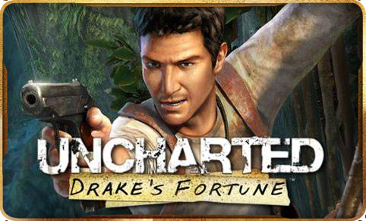
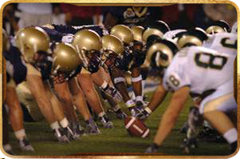
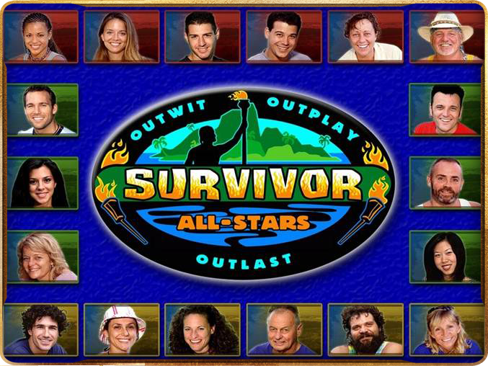
Story means different things in different games
Narrative vs. Mechanical vs. Social
(MMOs have all of these)

Slide 12
Story means different things in different games
Traditional BioWare games focus on:
  Backstory vs. Player Involvement vs. Player Directed
  Narrative vs. Mechanical vs. Social
  Linear vs. Branching vs. Freeform vs. Generative vs. Emergent

Slide 13
BioWare Pillars

Slide 14
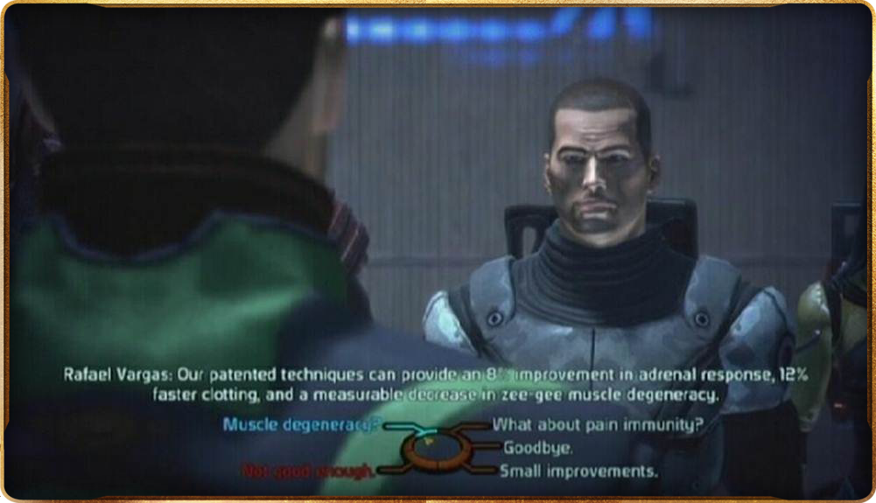
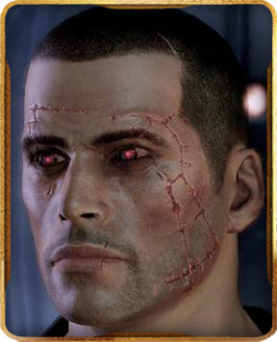
Choice

Slide 15
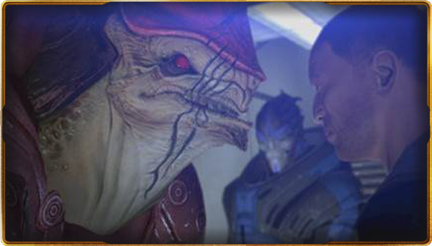
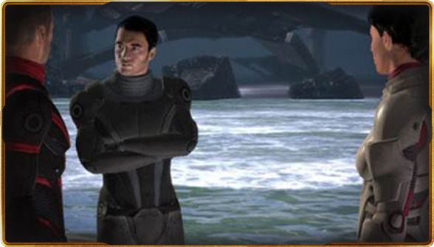
Consequences
Wrex and the Genophage
Ashley vs Kaiden

Slide 16
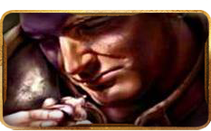
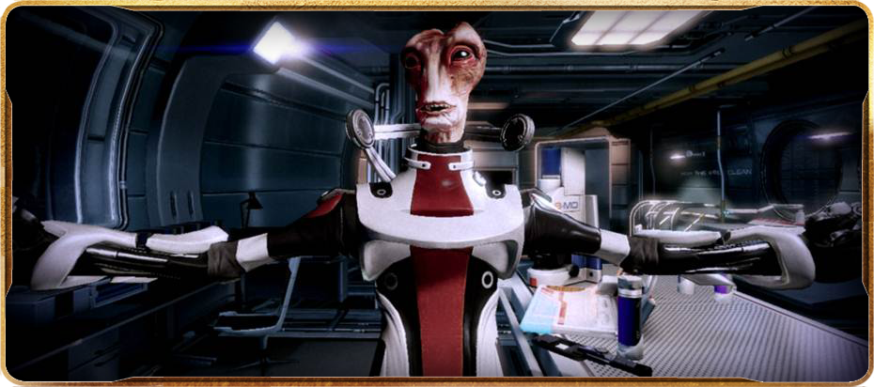
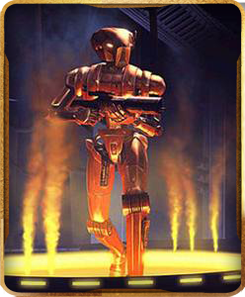
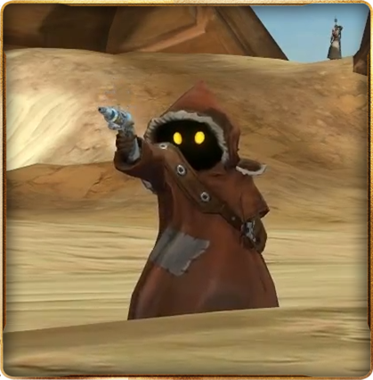
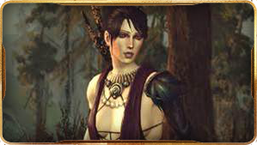
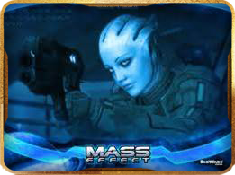
Companions

Slide 17
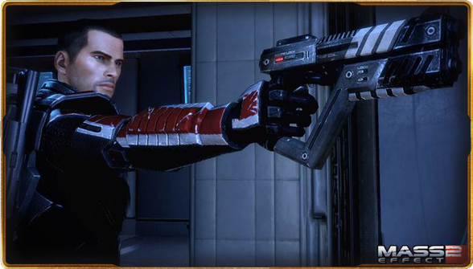
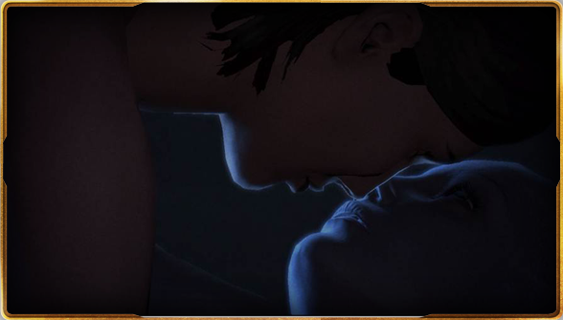
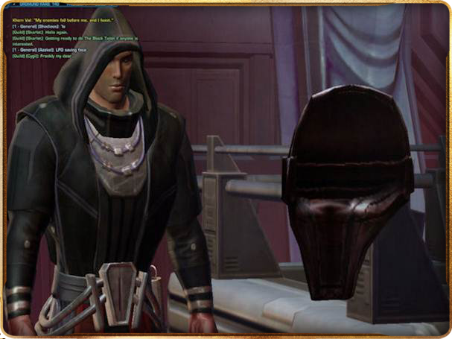
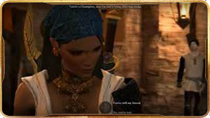
Cinematic Presentation

Slide 18
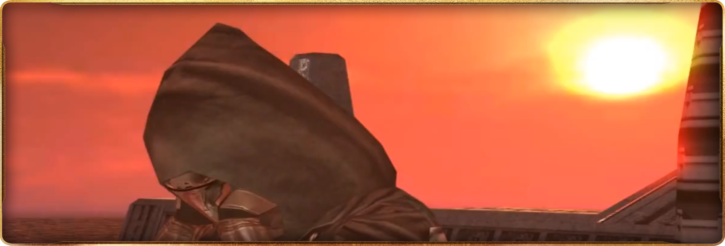
Content Quality

Slide 19
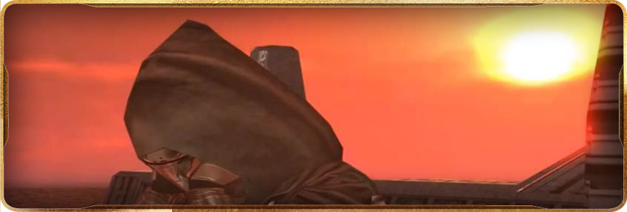
OK
So we want to do this. What unique challenges does an MMO bring to the table when building BioWare content?

Slide 20

Without A Net
Nature of MMOs means there is no save points or reloading story from past point
All decisions are final
No easy way to see ‘road not taken’
Consequences really matter
This actually proved to be marketable

Slide 21
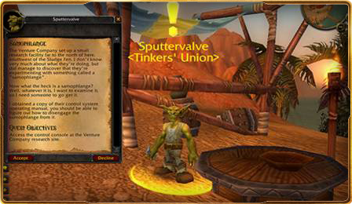
Staggering Amount of Content
Competitors had a staggering amount of content
  Factionally unique content vastly increases costs
Our quest content is more expensive
  Writing (which has to be done early)
  Voice Over
  Scripting (i.e. quest mechanics)
  Chained quests
  Forking

Slide 22
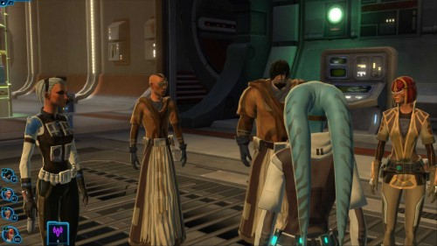
Multiplayer is Tricky
Group conversations playtested very well in the Neverwinter Nights model!
Voting on conversation nodes a winner!
Issues arose:
  Gathering players together to start a conversation
  Dealing with consequences of actions when you are outvoted

Slide 23
Consequences
Really hard to do stories that have BioWare impact in a shared space

Slide 24
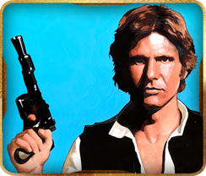
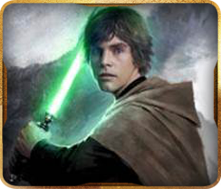
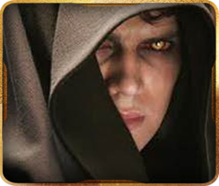
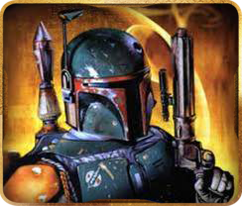
Class Stories
Wanted to tell stories that were true to the class – Smugglers shouldn’t have the same stories as Jedi Knights
  Means if people don’t play multiple characters, players see 1/8 of our best content

Slide 25
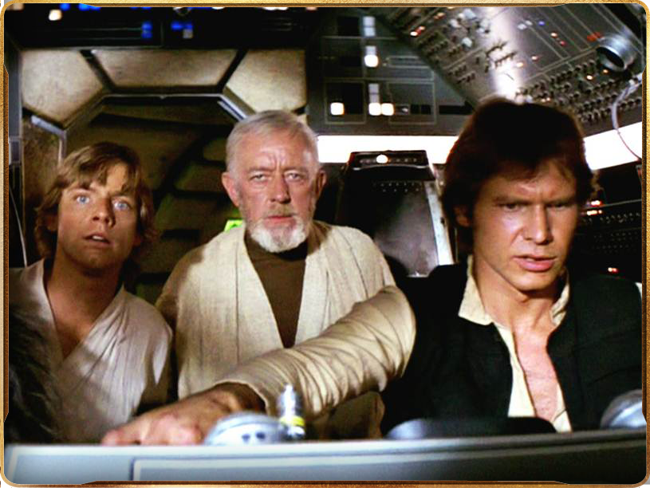
That’s no moon!
I’ve got a bad feeling about this
Challenges we Faced

Slide 26
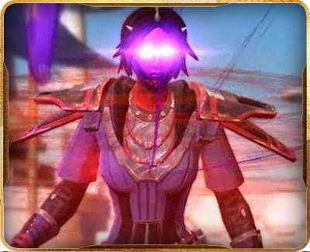
Incubation Time
8 unique class missions lines from levels 1 to 50
Factionally unique missions on each side resulting in 160 hours targeted playtime
Full VO for players and NPCs
  Includes setting up infrastructure to find actors, manage scripts, track pronounciations, etc
Many readthroughs and approvals (internal, Lucas, etc)
Localization to French & German
  Including VO!
“The equivalent of 24 KOTORs” is in the right ballpark

Slide 27
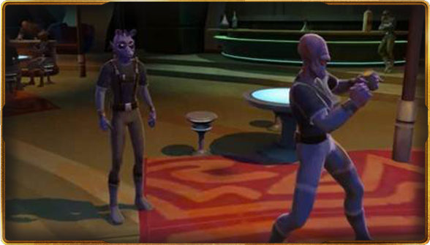
Incubation Time
Our writing department was the first fully staffed department at the company – 8 full-time writers
  My previous project had two half-time writers
They were all hired before we had:
  Narrative writing tools
  World builders to build what they wrote
  Firm game mechanics

Slide 28
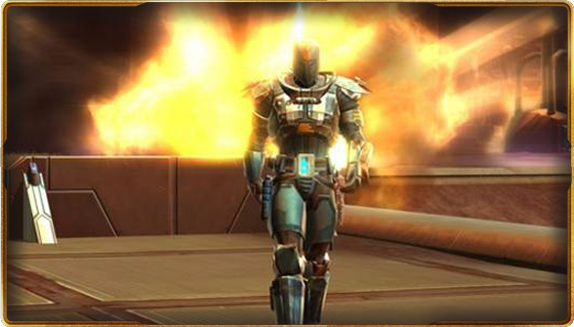
Amount of Content
AT LAUNCH
260,000 lines of dialogue
321 Actors
4,094 Characters
17 Recording Studios
1,600 VO sessions
Almost 275 hours of VO total
  Doesn’t count aliens and other non-English speakers!
  And we’re still adding more stuff!

Slide 29

Too Many Quests
Quest Hubs used to have 5-6 quests
Turned out to be too much of a good thing – too much talking
  Players had trouble tracking the various storylines
Simplified some quests to use alternative quest delivery mechanisms
Many were just thrown away

Slide 30

Conversations Too Long
Took us a while to find the optimal conversation length
  Early conversations needed to be rewritten or have VO thrown away
Patience gets shorter the farther you get into the game, and more trivial the quest content
Social aspect has really weird effects on patience with conversations

Slide 31

Problem Quests
Often, VO was recorded and localized before we found a problem with the quest
  Often happened late enough that rewriting/rerecording were not viable solutions
Solutions:
  Cut the quest
  Insertion of non-English speaking NPCs

Slide 32

Group Missions
Group conversations were awesome!
Gathering a group on the other hand, was tedious and annoying
Made worse when class quests would lead to different places
Quest chaining and forking were made messier with group

Slide 33

Holo
“Holocom” technology was our solution – allowed you to join a party member’s conversation from wherever you were

Slide 34

Forking
Forking made joining and sharing quests difficult
Forced us to simplify many quests

Slide 35

Staying in Sync
Writers originally wrote quests so that different classes went to different quest hubs at different times
Playtesting showed that keeping player’s quest destinations in sync became a high priority
Subtle differences in mission length had huge social impacts
Philosophy of ‘class stories are done alone’ had to change

Slide 36

Ambushes
Players ‘getting jumped’ when they hit certain story points resulted in many design adjustments
Writers had to have clear rules of when ambushes could happen
Ambushes limit ability to let players teleport around the world
We abandoned the idea of ‘hidden ambushes’ – making them less ambushy

Slide 37

Mission Consequences
‘Rolling’ to win conversations was very popular
Light Side/Dark Side system can’t penalize players for making a choice they don’t agree with
  Choices were frequently ‘grey’ with arbitrary results
Solution: you get rewarded for your choice not the result

Slide 38

Mission Consequences
No saves means choices are permanent
Many on the team (and many fans) saw this as evocative and compelling
Still, ESC to leave any conversation was one of our first design decision
  Once the conversation is concluded, responses are final
  ESC was less than optimal in group situations

Slide 39

Mission Consequences
This companion character was always meant to die
…but doing so would cost you your healing companion

Slide 40

Quality Assurance
Our QA dept loved testing:
  Forking Conversations
  Gender and Species Variants
  Complex scripting
Class Quest Blockers were considered high priority must-fix, call-in-sleeping-designer level bugs

Slide 41

So How’d We Do?
85% Metacritic
Story was frequently cited as top strength of game

Slide 42

Questions?

