Slide 1
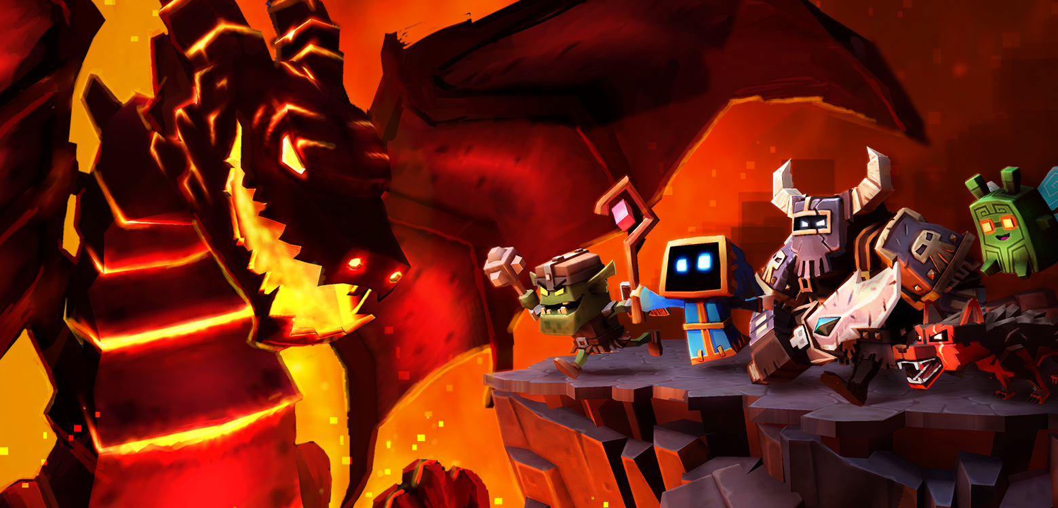
Embracing the Paradigm Shift
Converting a Premium Team to an Enthusiastic Freemium Team
Damion Schubert
Design Director, Boss Fight Entertainment
GDC 2015

Slide 2
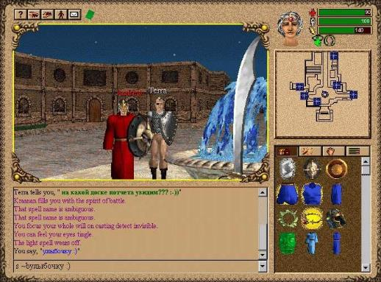
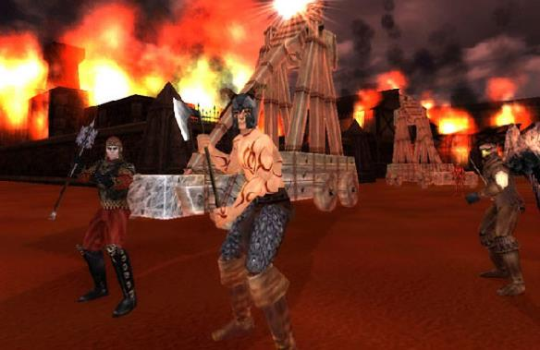


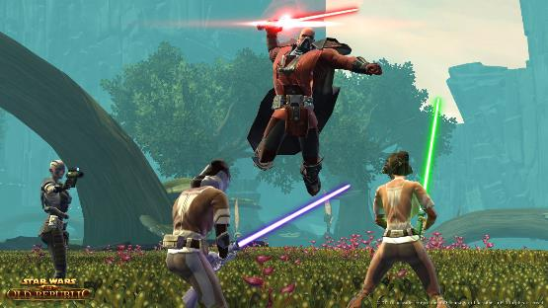

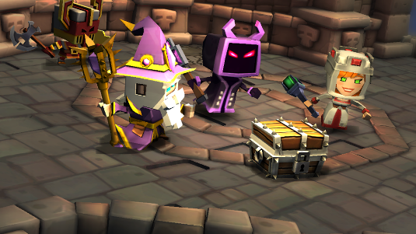

My name is Damion Schubert, and I have almost 20 years design experience, mostly working on premium massively multiplayer titles.

Slide 3
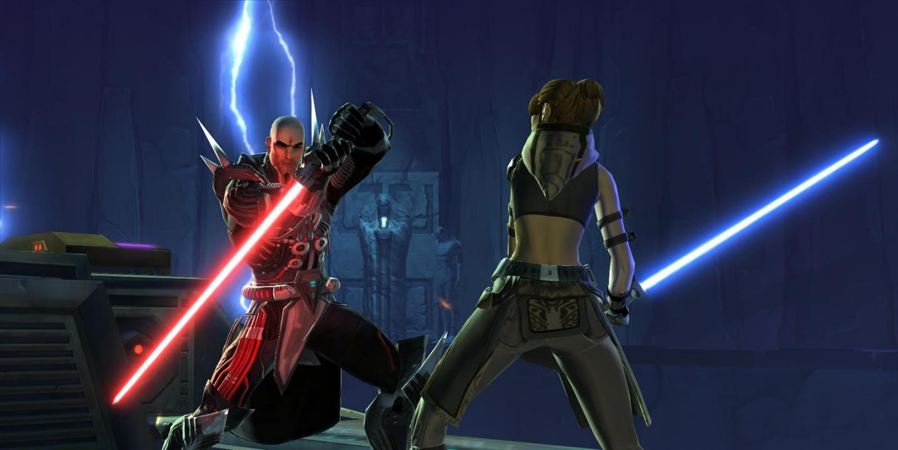
I am a relatively new to F2P design, though. Star Wars: The Old Republic was my first foray into this design space.

Slide 4
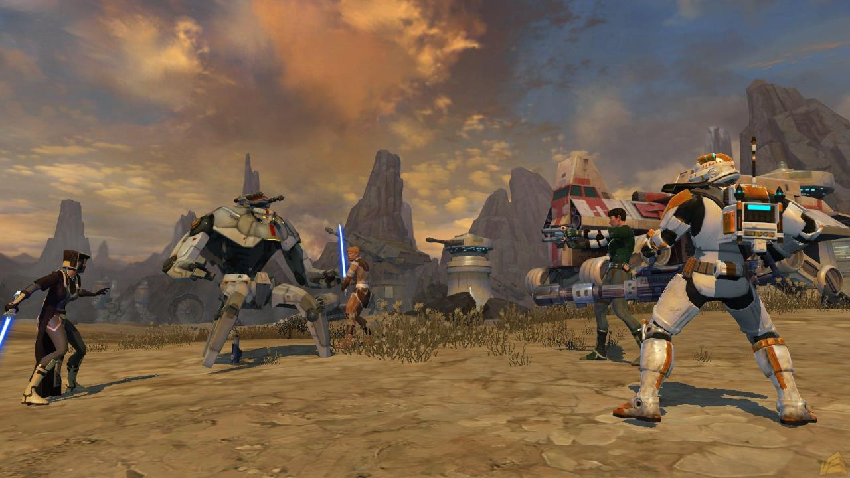
The effort was highly successful, doubling revenue, 2M new downloads quickly, massively increasing DAU, significantly increasing subscriber numbers.

Slide 5
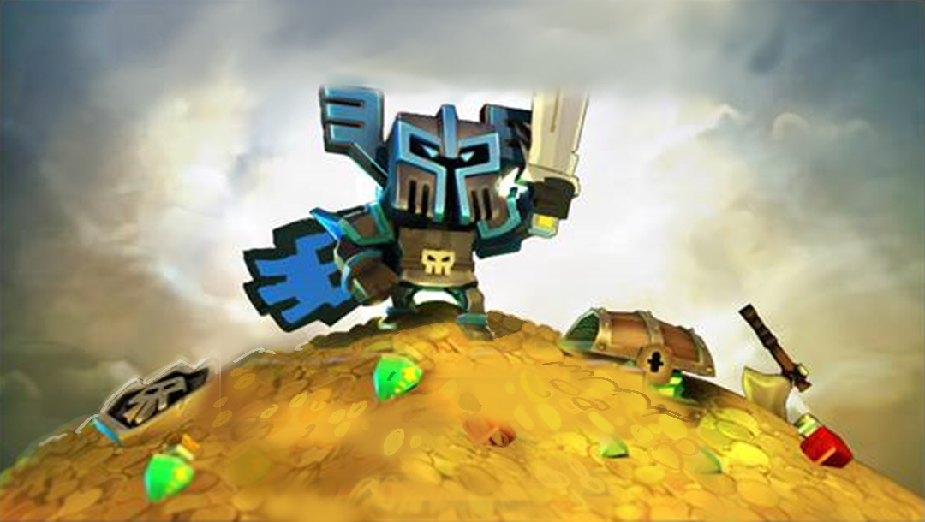
I want to talk instead about the journey, and how a team was led kicking and screaming into embracing free to play.

Slide 6
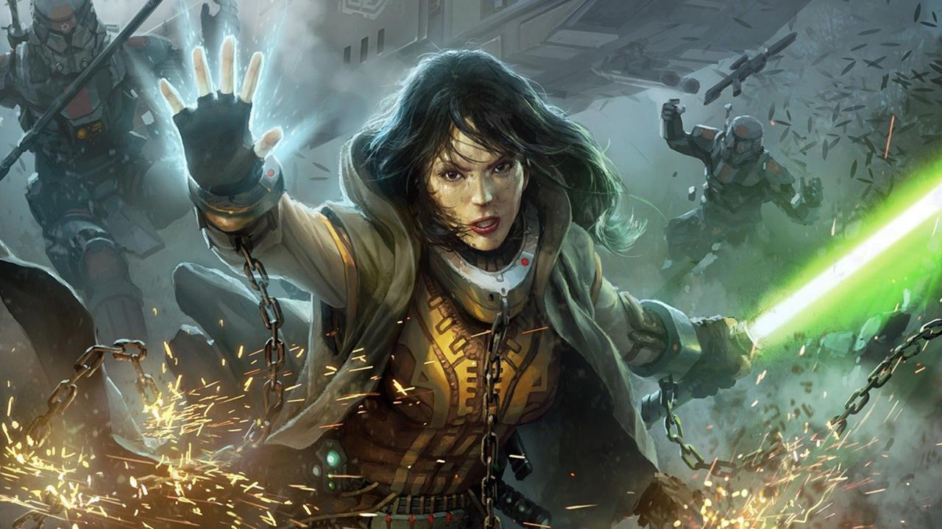
In mid 2012, it was clear that SWTOR was not matching expectations, and that EA expected a course correction into Free to Play.

Slide 7
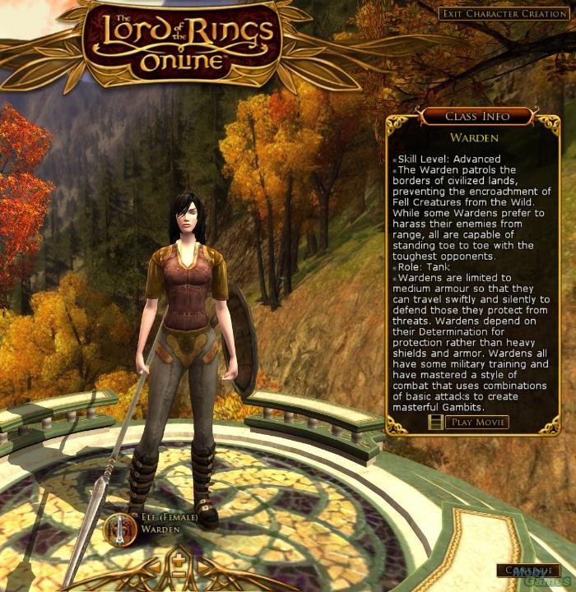
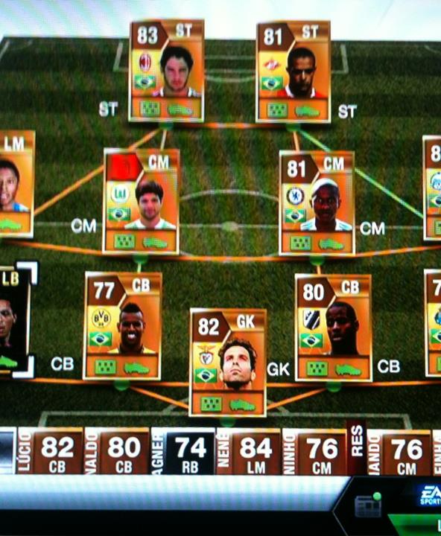
We began heavy research – talking to anyone who would give us the time of day, learning what we could about what had come before.

Slide 8
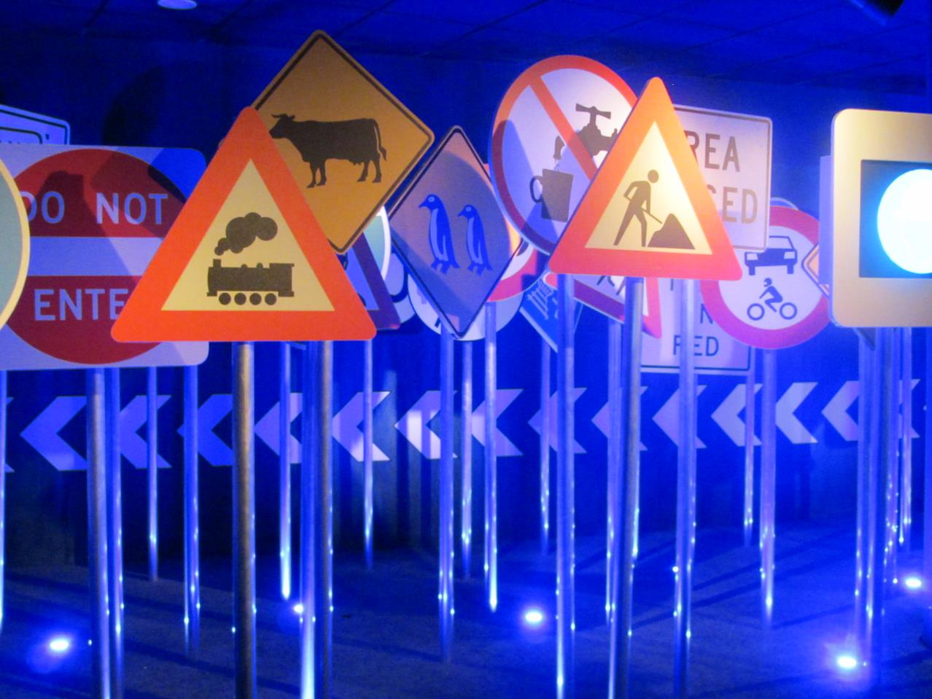
Along the way, on some of these other teams, we saw a couple of troubling trends – warning signs that might affect team morale.

Slide 9
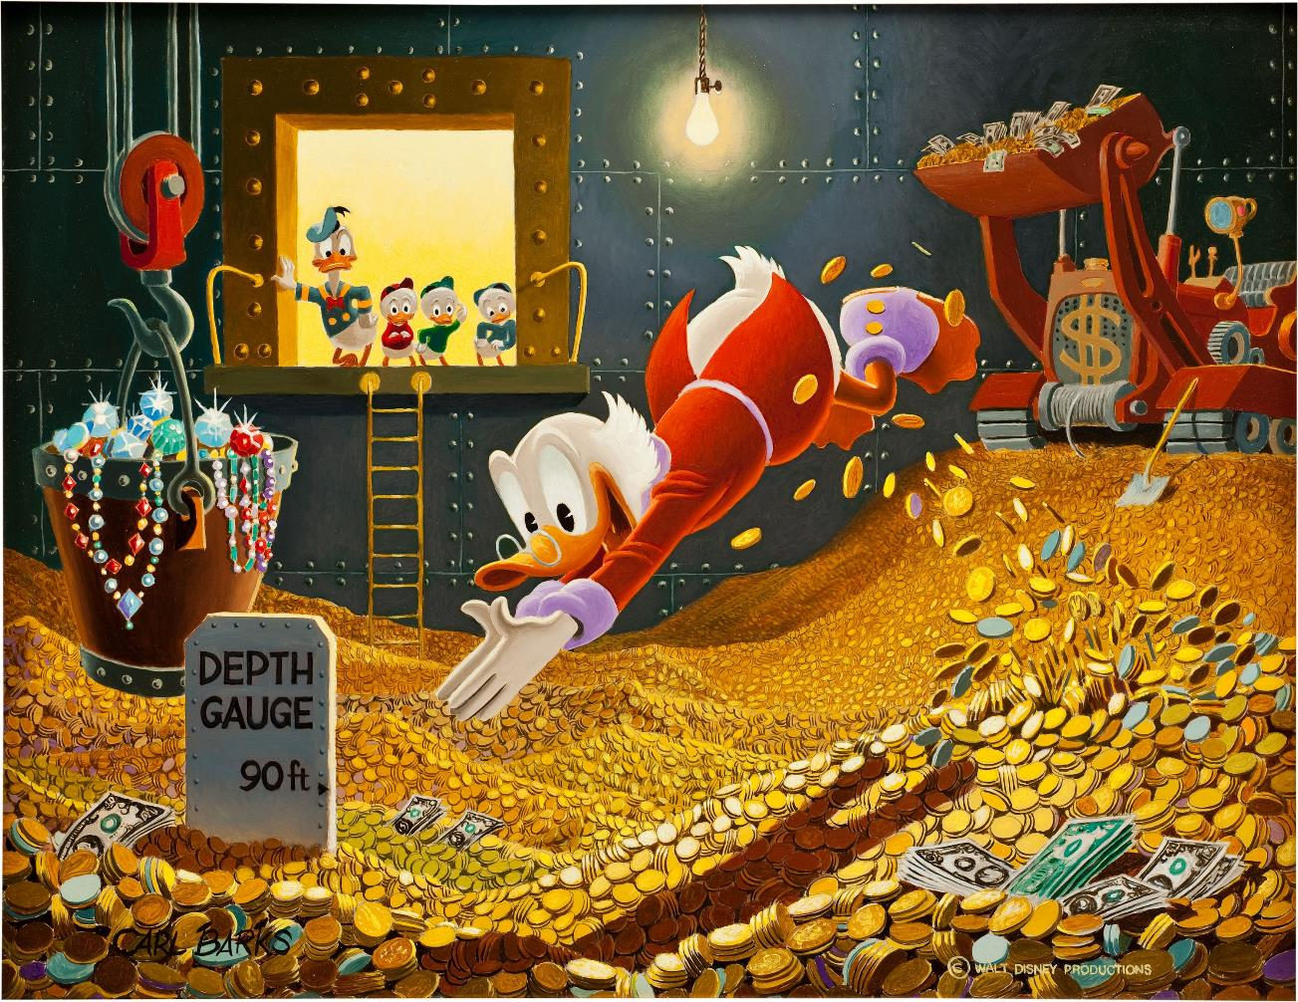
The first was unbridled greed – developers who were uncomfortably ecstatic about the massive earnings potential of microtransactions.

Slide 10
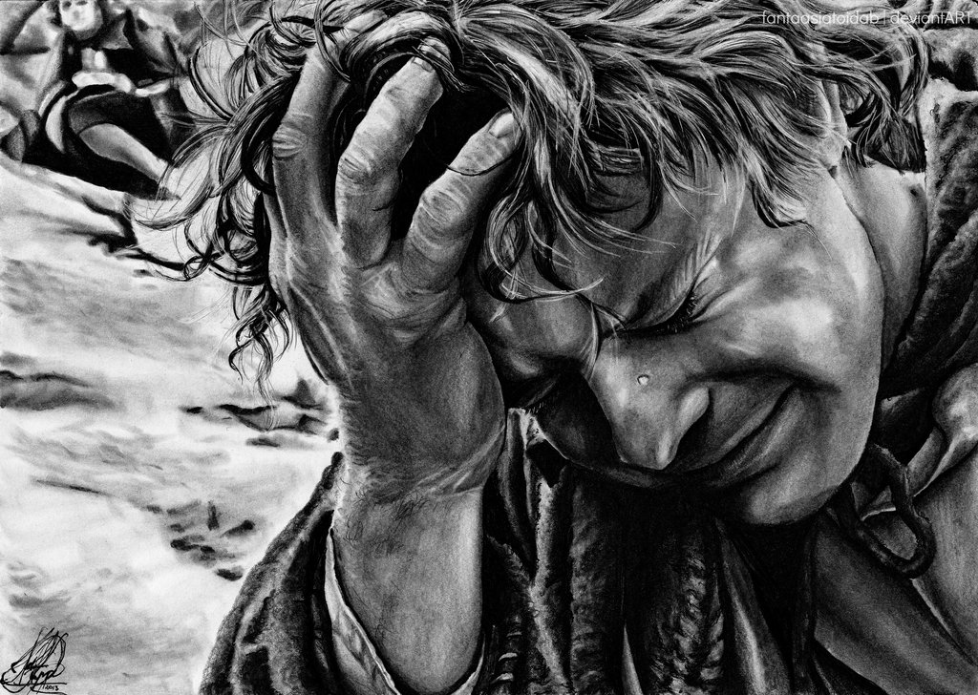
The second was despair– developers who were incredibly depressed about having to monetize their games.

Slide 11
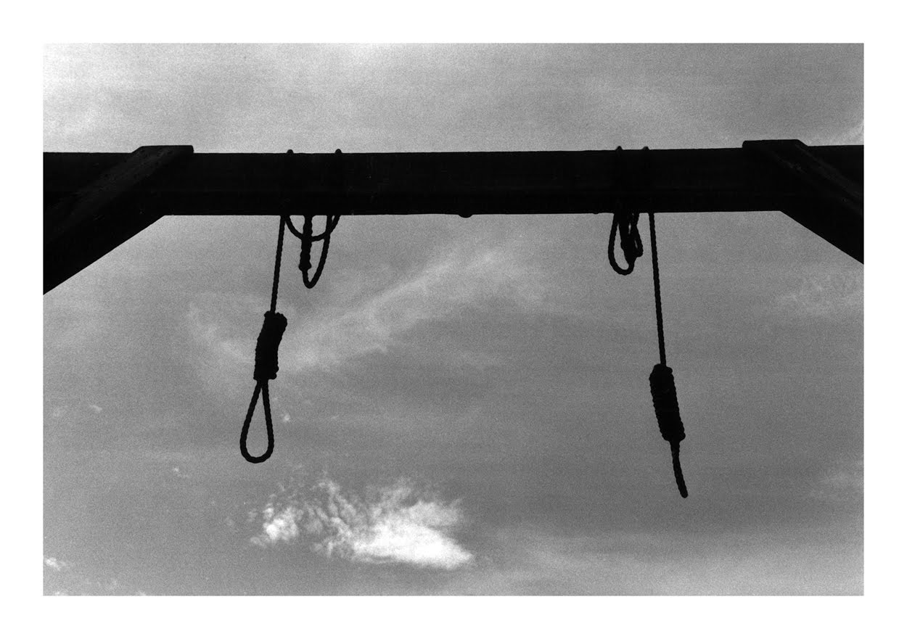
They’d say things like ‘I’m witnessing the death of the games industry – and I’m part of it.”

Slide 12
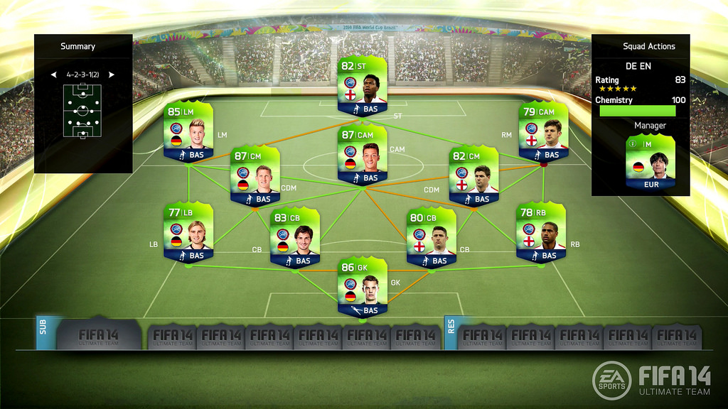
The success stories tended to be about respecting your customers, and ensuring design works seamlessly with monetization.

Slide 13

And that’s when I had my epiphany. Well, a series of them.
And that’s when I had my epiphany.

Slide 14
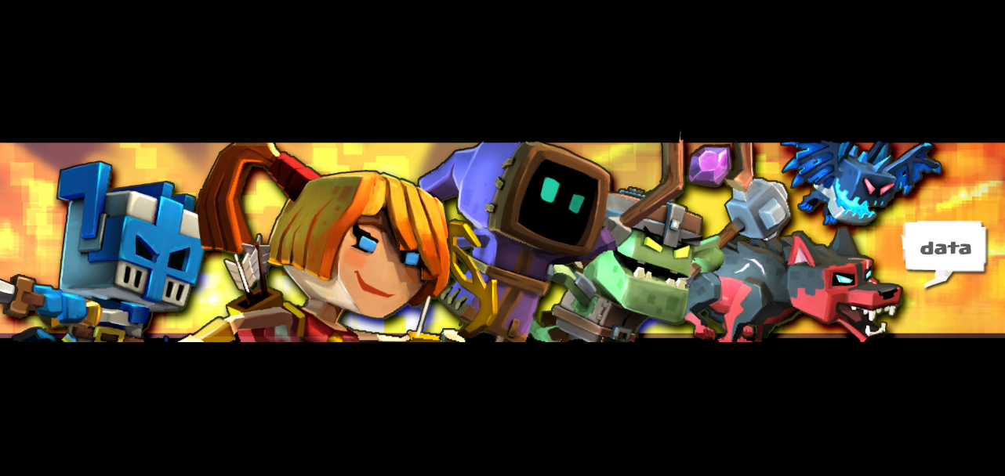
Free is good!
And that’s when I had my epiphany.

Slide 15
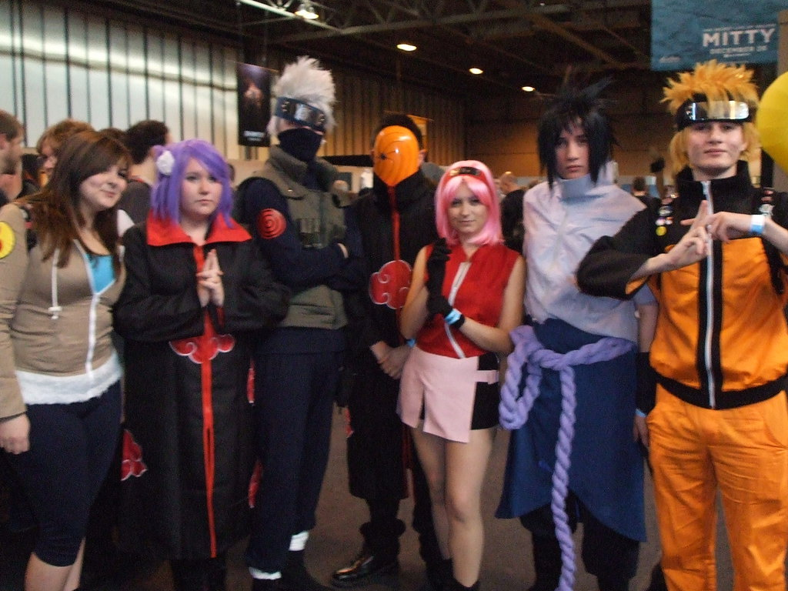
Free is good – for the CONSUMERS. We’re doing it because the market demands it, not because the publishers want it.

Slide 16
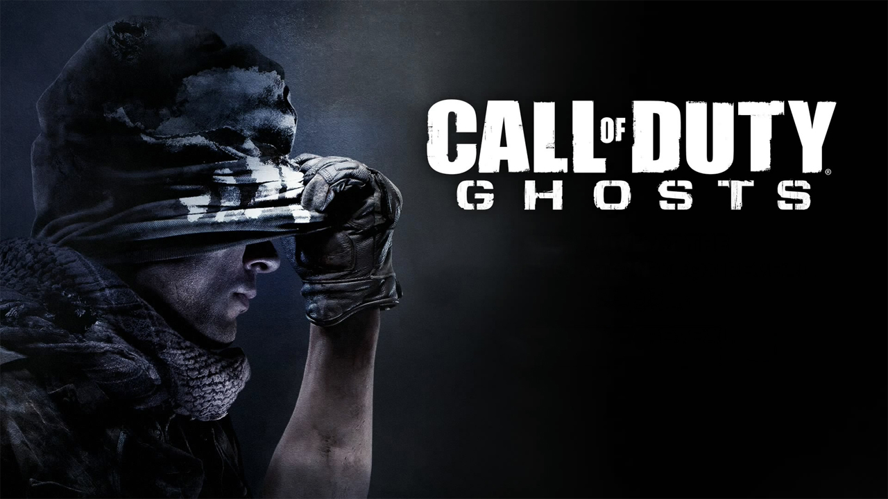
Big publishers like Electronic Arts and Activision would have been happier if things had never changed – they were winning that game.

Slide 17

Gamers from my generation also look at ‘free’ suspiciously –it’s too good to be true. They see it as cheap, bargain basement stuff that’s likely a ripoff.

Slide 18
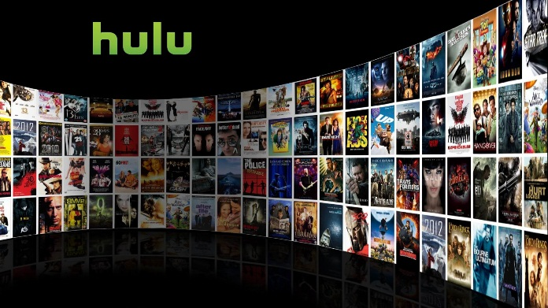
The kids today don’t see it that way. They are used to get absolutely everything for free, from music to movies and everything in between.

Slide 19
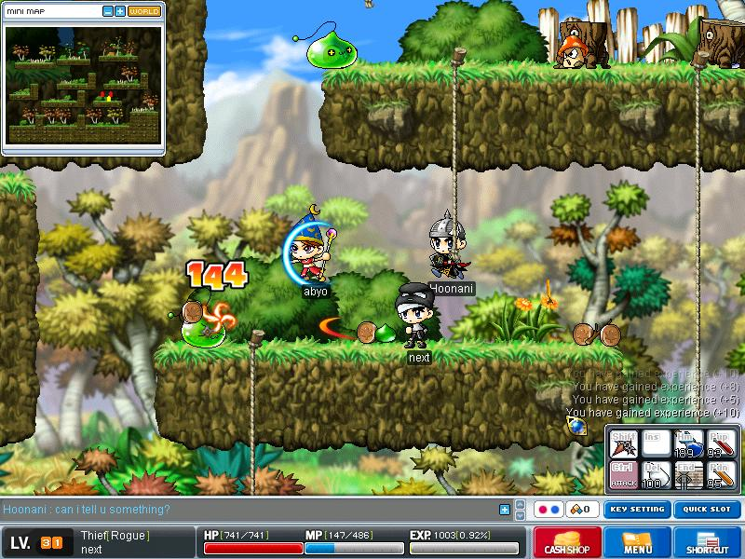
Many of them were introduced to gaming on free games, such as MMOs like Maple Story, Runescape or Wizard 101.

Slide 20
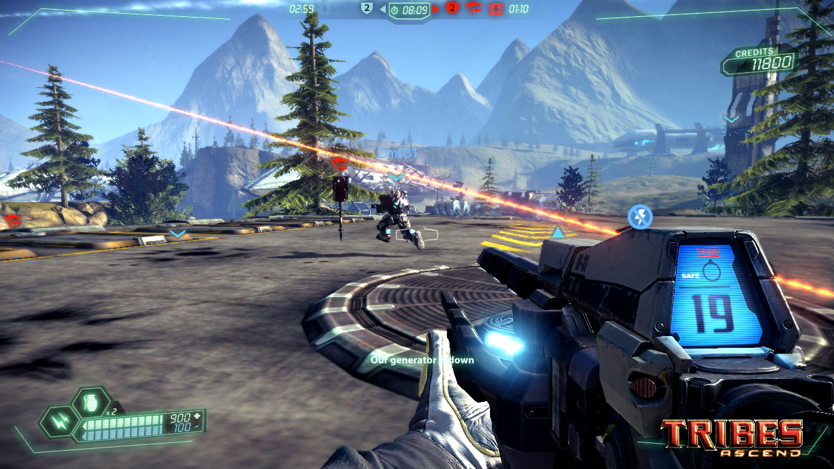
With the advent of League of Legends and Tribes: Ascend (among others), this now also includes highly polished AAA game experiences.

Slide 21

There is so much free entertainment available that there is no reason for someone to pay money unless they decide to emotionally commit.

Slide 22
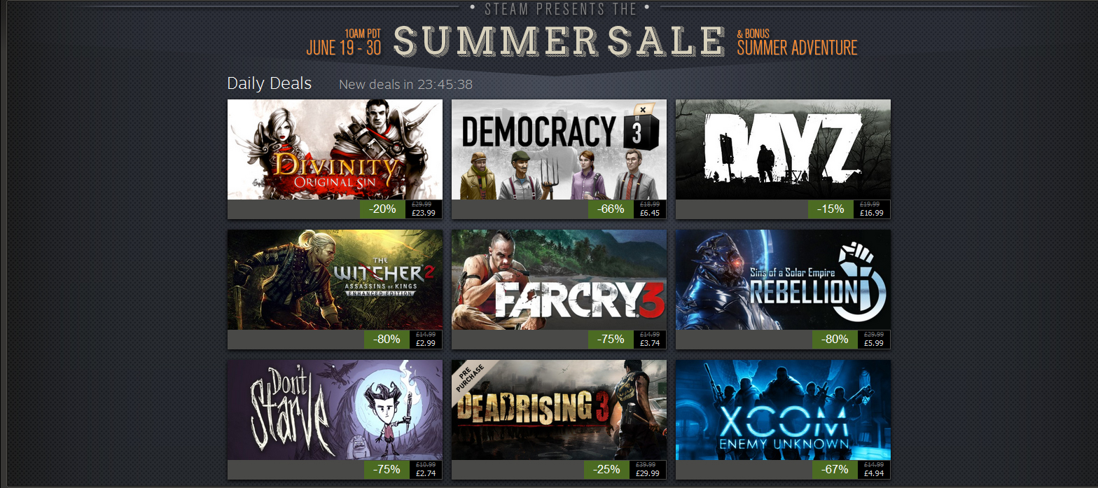
Digital distribution has created a near-infinite competitive landscape, and some entries are always competing on price.

Slide 23
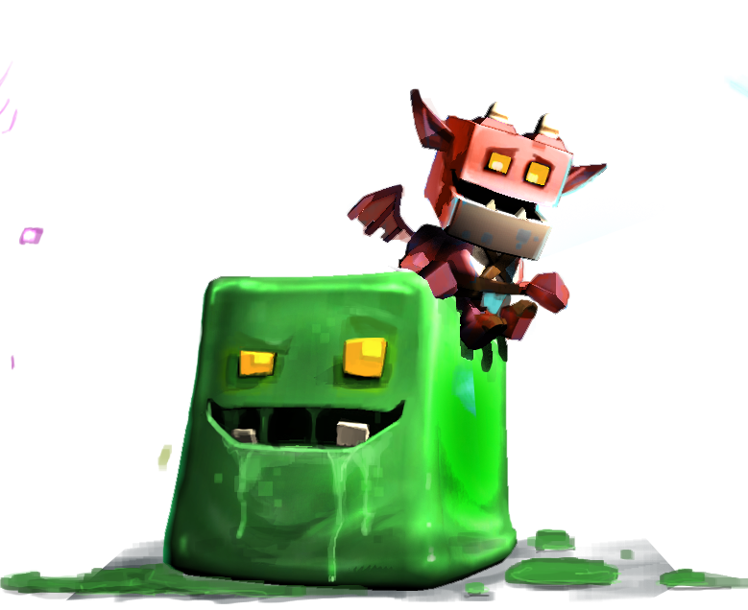
Epiphany #2: Things are going to get ‘more free’.

Slide 24
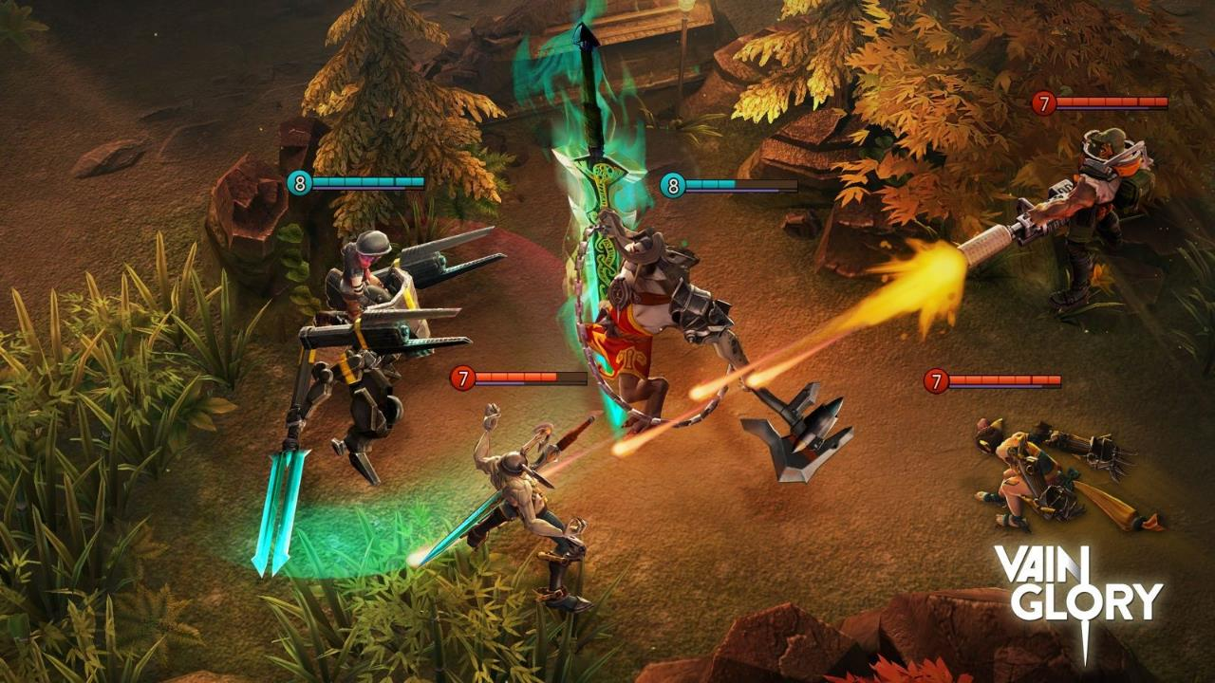
Can you imagine someone releasing a MOBA with a box price now? This will happen to other genres one by one.

Slide 25
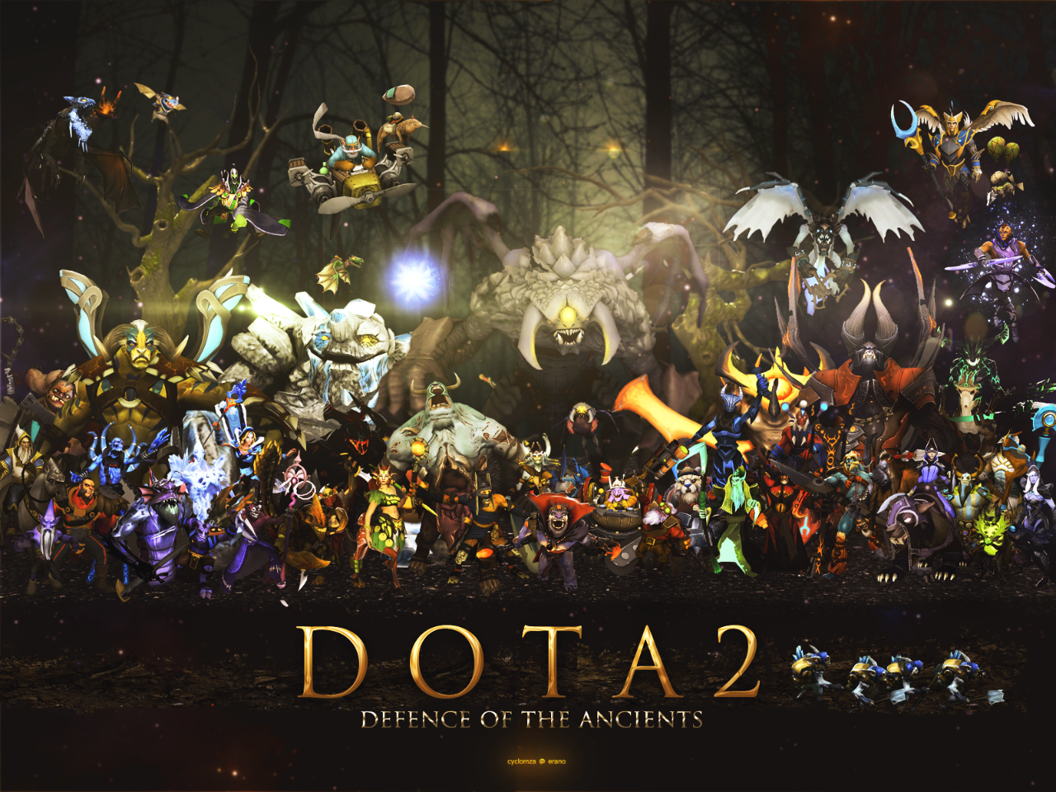
And genres will feel pressure from competitors to push prices down and get rid of bad experimentation, such as DOTA 2 not charging for heroes..

Slide 26
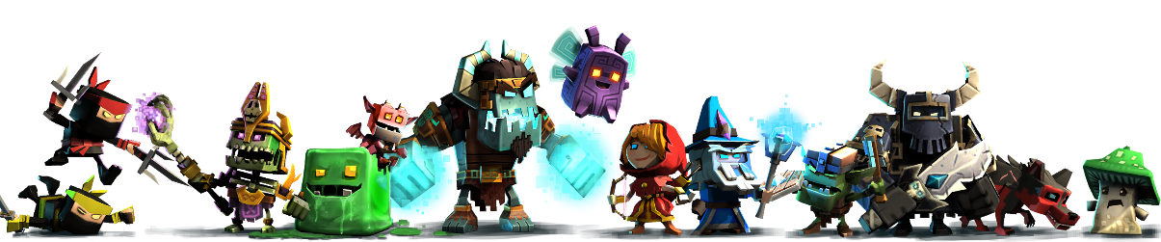
So if free is inevitable. How do you get a team on board? By reminding them that they are giving away the gift of gameplay to millions of fans.

Slide 27
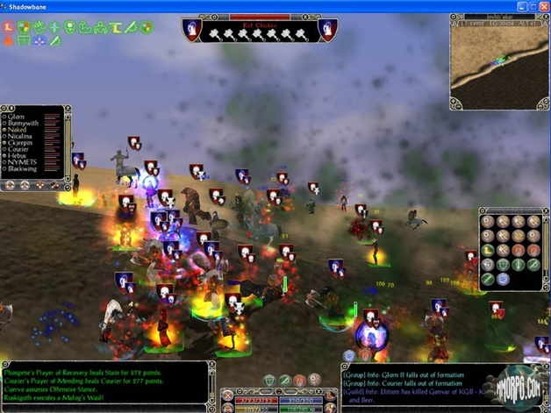
Shadowbane went F2P before they closed it down. So many players surged in that Ubisoft kept it open another two years – with no monetization plan!

Slide 28
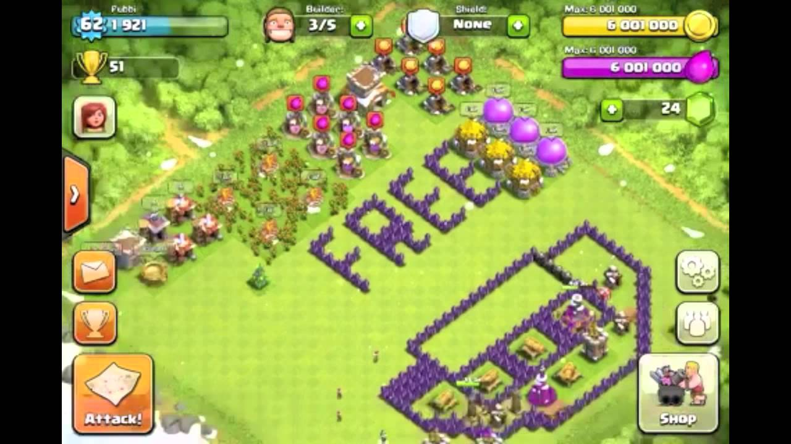
Epiphany #4: Free means actually free for the majority of your players. It should be how the game is playtested internally.

Slide 29
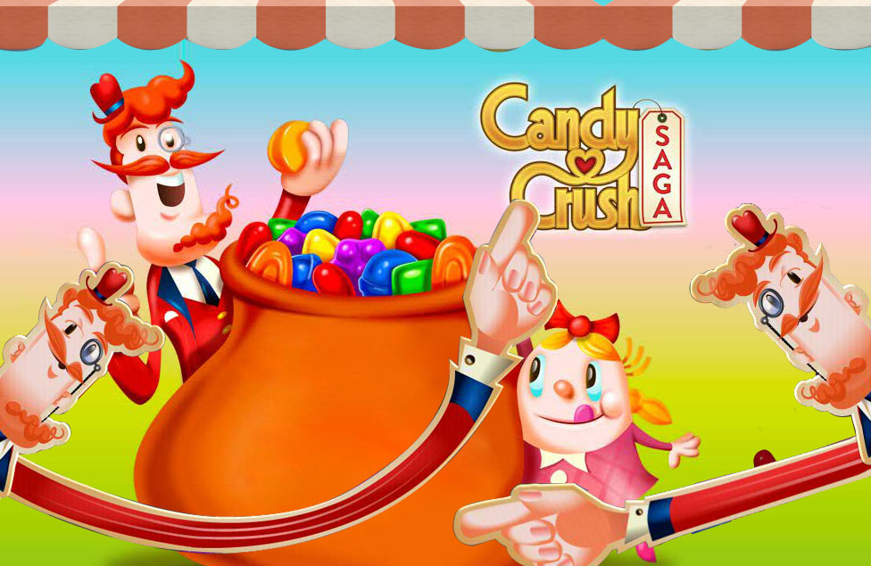
In Candy Crush Saga, 70% of all customers who finish all levels do so without spending a dime.

Slide 30
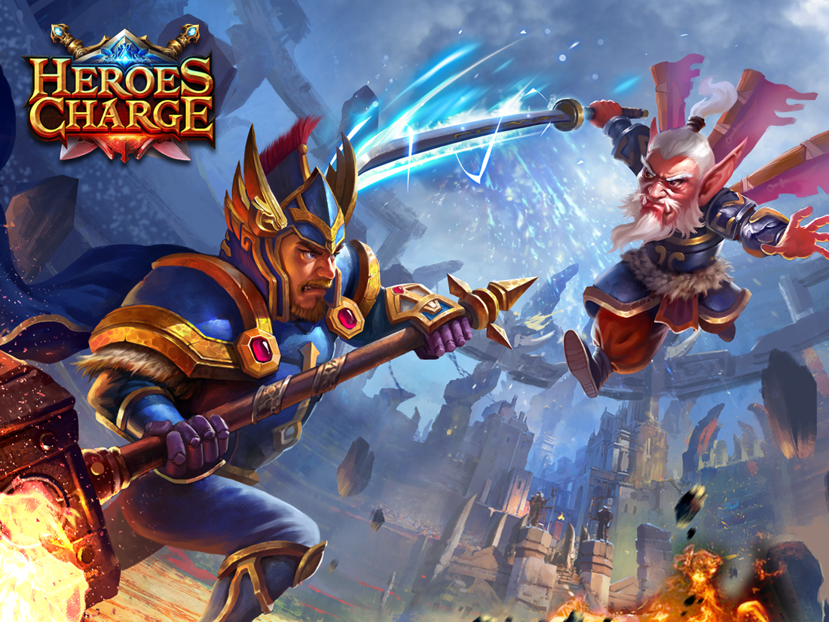
One thing most Free to Play blockbusters have in common is a high level of generosity, especially early.

Slide 31
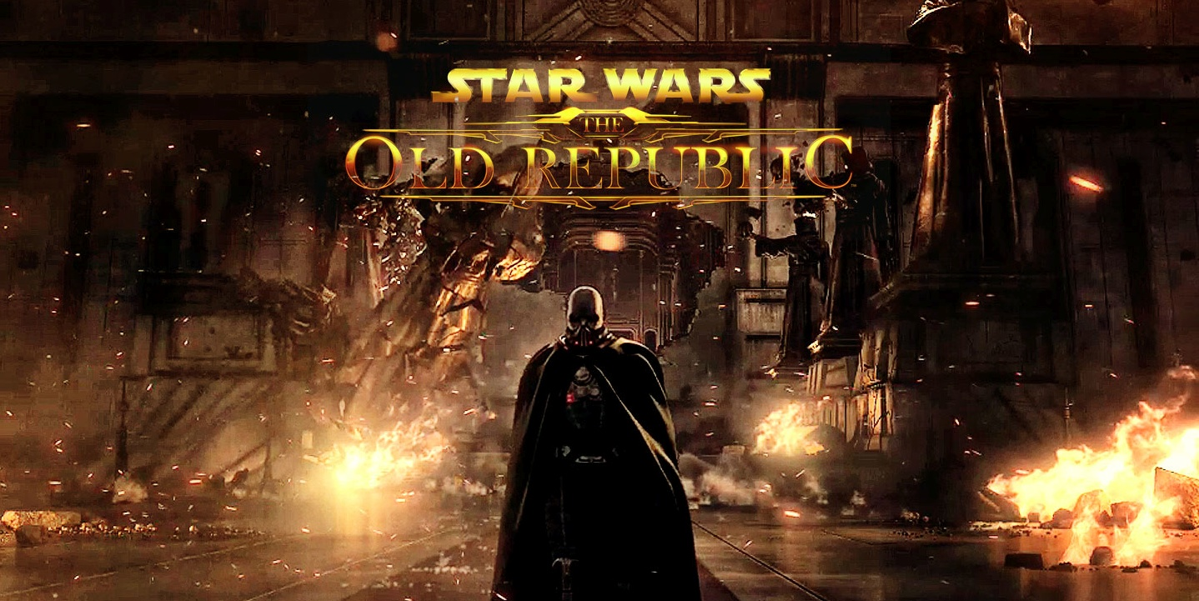
When converting SWTOR, we left the opening planets (first 5 hours) untouched – so they’d fall in love with the game before we asked for money.

Slide 32
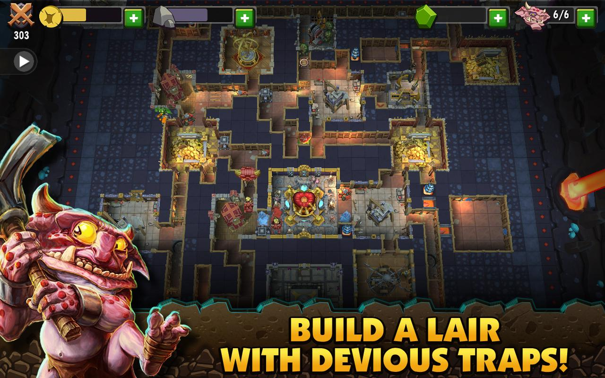
By comparison, many F2P games ask for money too soon, or lock the core game loop behind an immediate energy purchase.

Slide 33
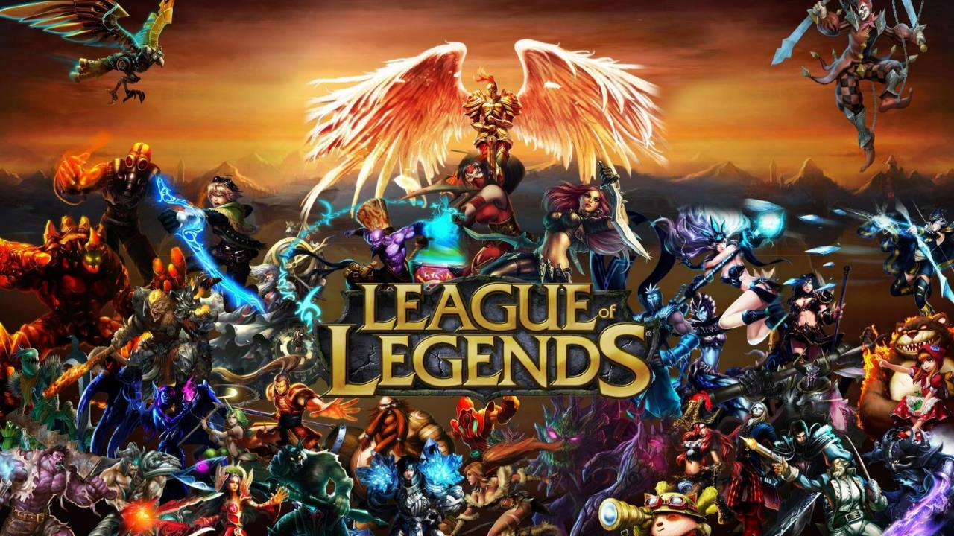
How free a game is actually is core to that game’s virality – how much hardcore fans will evangelize it to cheapskate friends.

Slide 34
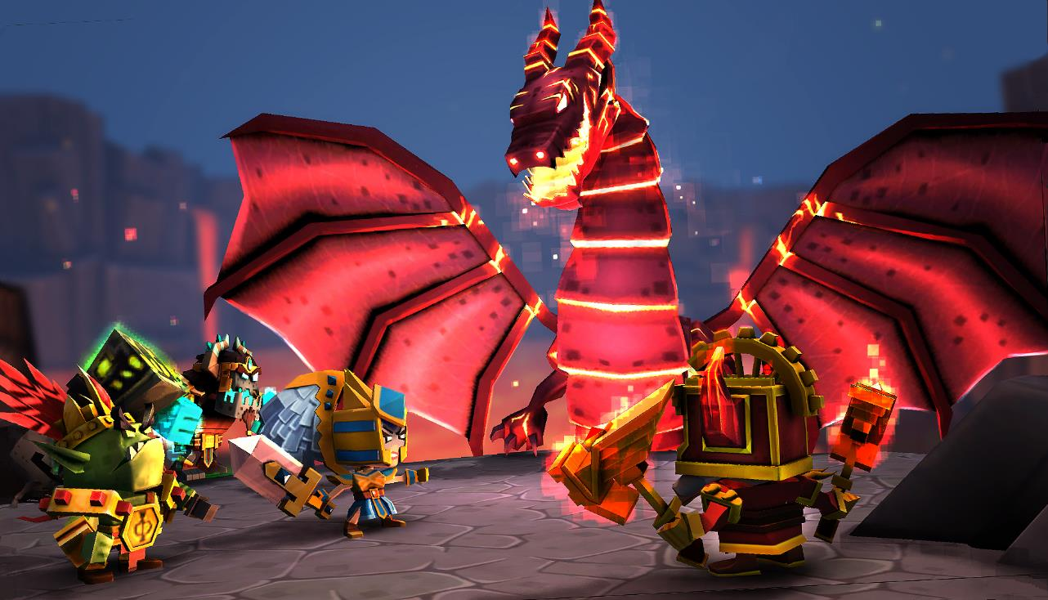
So we have the team embracing ‘free’
How do we make money?

Slide 35

So we have the team embracing ‘free’
I think we all can agree that it’s pretty important for game developers to be able to pay their rent.
How do we make money?

Slide 36

Also, the companies that fund us are not doing this out of charity.

Slide 37
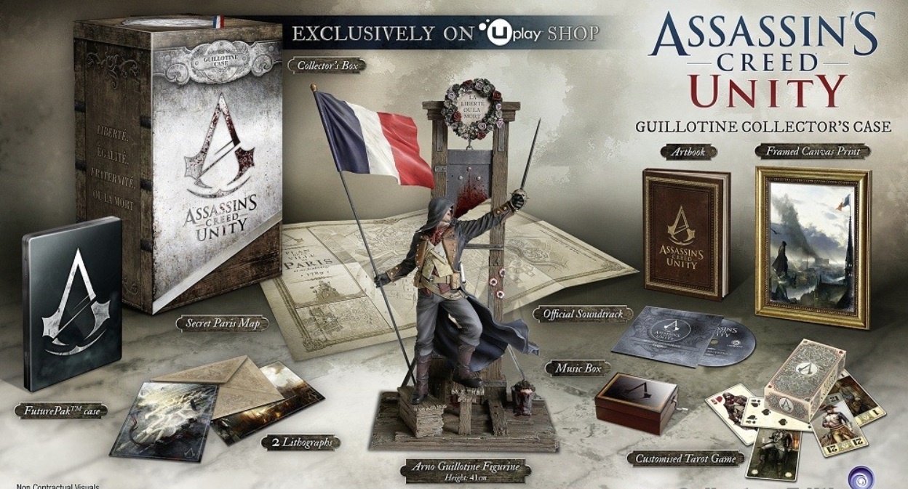
And hopefully we can agree that the $60 price point and $100 collector’s edition model ALSO has opportunities for exploitation.

Slide 38
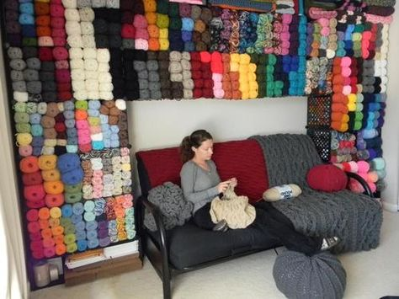
People WANT to spend money on their favorite hobbies. Your job, as the designer, is to make something they can love enough to invest in.

Slide 39
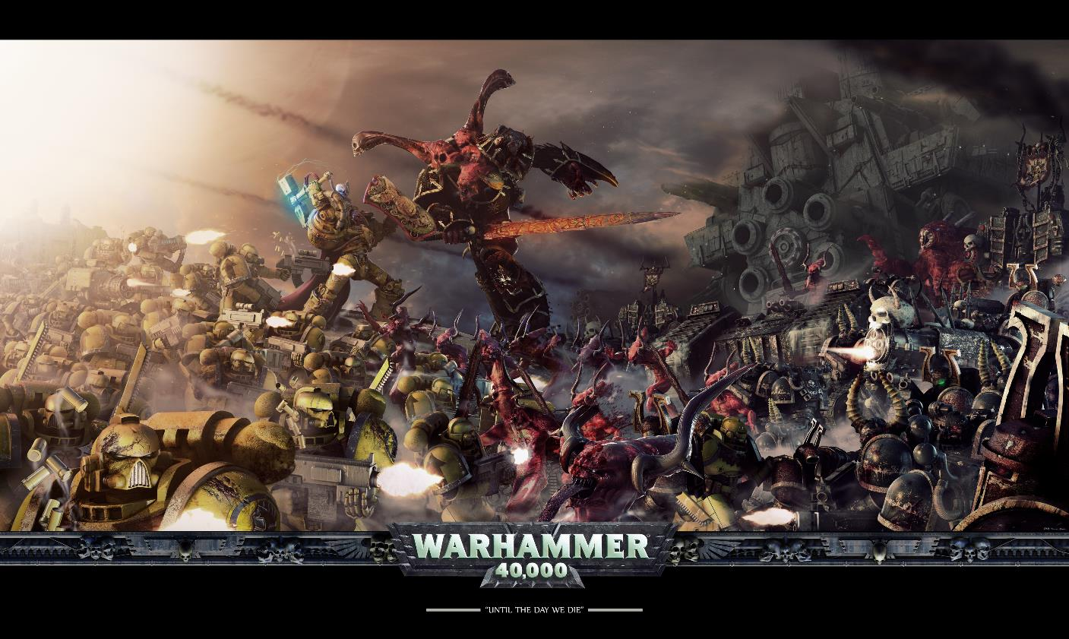
Charging money for games is fine – hell, MONEY games are fine – as long as you have a transparent value proposition the player can understand..

Slide 40
Designers need to know the classic ‘willingness to spend’ chart, and how F2P massively increases players & potential revenue.

Slide 41
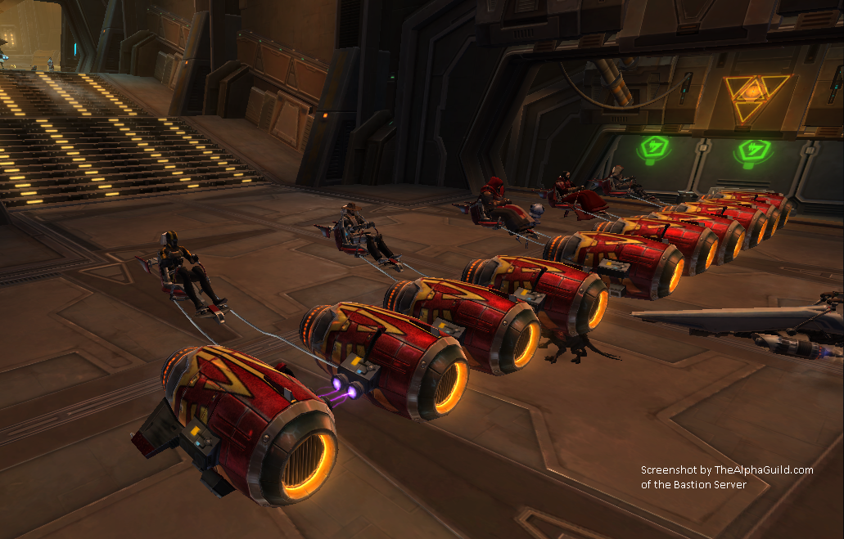
Epiphany #5: Designers need to see the numbers. Designers who know what sell will better capitalize on available resources.

Slide 42
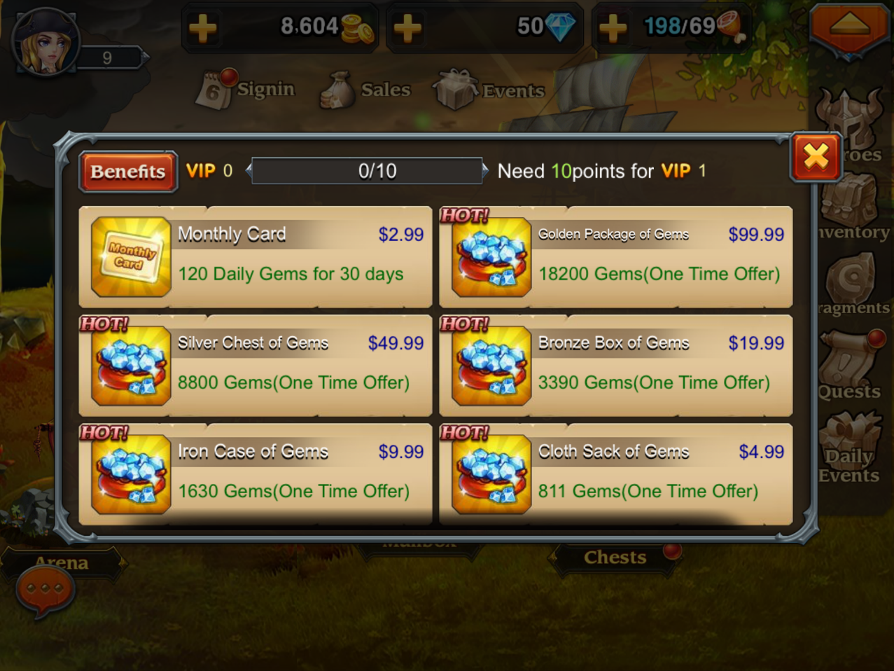
Games should have an ‘obvious first purchase’ – ‘’If I spend only 5 bucks on this game, clearly this is where I spend it’.

Slide 43
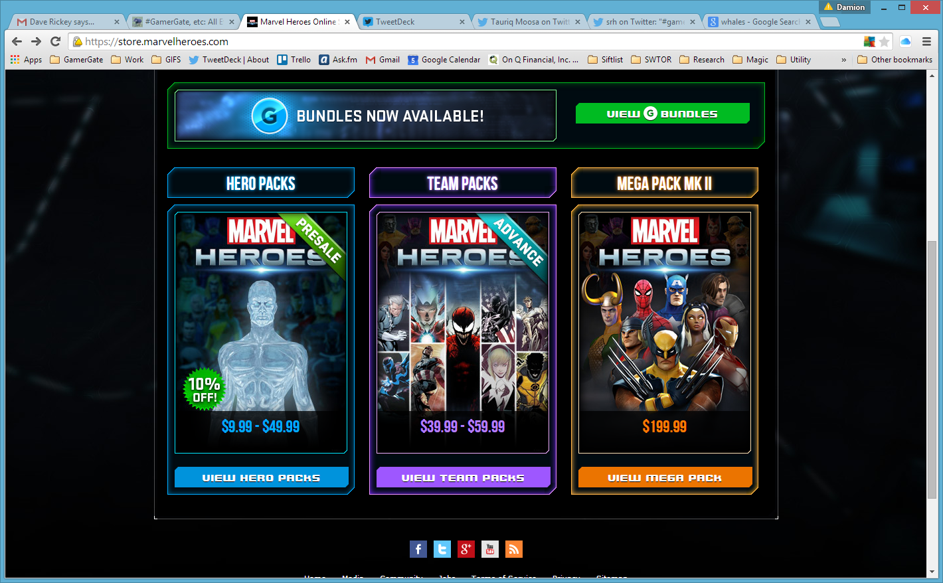
Designers should imagining that everyone could become a whale and instead talk about what a ‘reasonable person’ would spend.

Slide 44
In this way, you start to look at how to move players up the ‘happy to spend’ chart. Can you do that by making them happier?

Slide 45
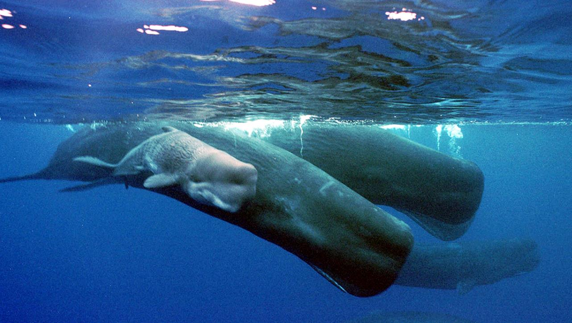
We need to think of whales as Patrons – generous benefactors who subsidize gameplay for hundreds of free players.

Slide 46
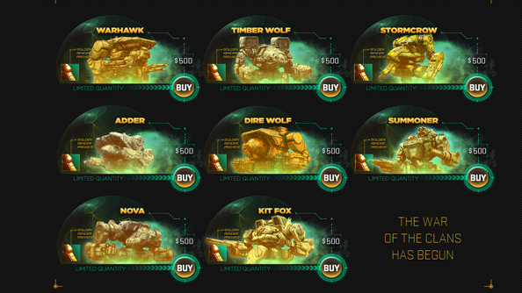
And designers need to be extremely wary of how attempts to reach the 1% are seen by the other 99%.

Slide 47
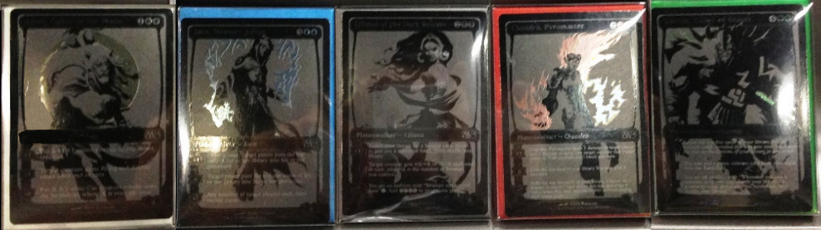
Heavy spending should culturally be a point of pride and celebration, not one of shame.

Slide 48
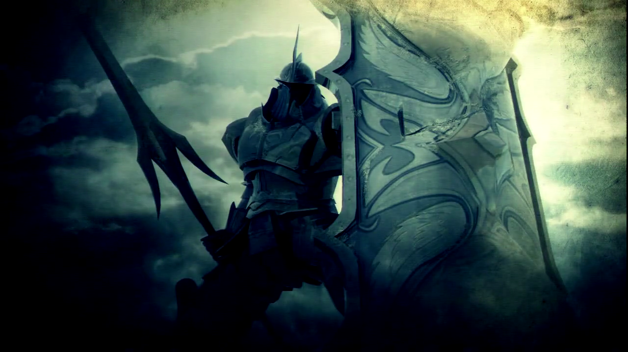
Last Epiphany: It falls on designers also need to protect the customers. Someone in that room needs to be their advocate.

Slide 49
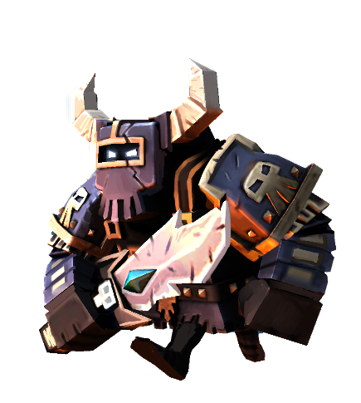
In Conclusion
◊ Embrace ‘free’ as preferred by the marketplace.
◊ Ensure the game is free enough for players to fall in love with it.
◊ Understand the idea of willingness to spend variance.
◊ Treat and celebrate whales like cherished patrons.
◊ Defend the players from the forces of evil.

Slide 50
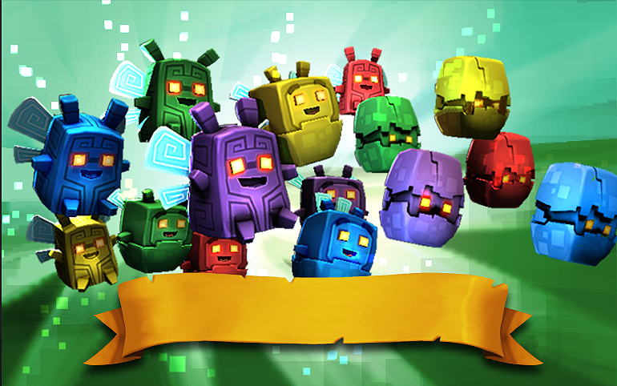
Questions?

